Slide 1
Introduction Windchill 11 Module 7 Compound Management

Slide 2
Concept Introduction

Slide 3

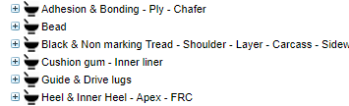

Windchill Compound Objects
Parts Objects:
Documents Objects:
Compound Formula
Compound Spec Document (Word)
Raw Material Technical Spec Doc. (xls)
SDS – Security Data Sheet Doc. (Misc.)
Raw Material

Slide 4
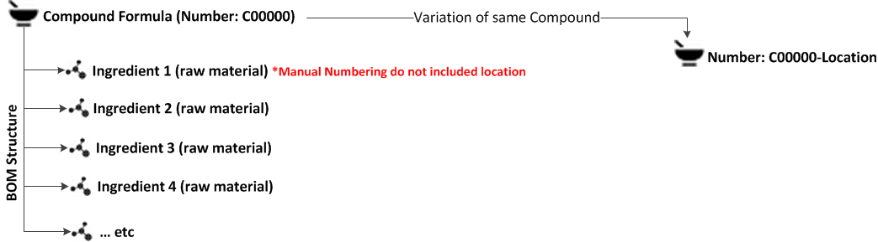
Windchill Compound Object
Structure and relationship
*Autonumbering
0#C###
01C001
01C001-mixingLocation
OIR
<Value algorithm="wt.rule.algorithm.CaseBranch">
<Value algorithm="wt.rule.algorithm.EqualsTest">
<VarRef id="compoundType"/>
<Arg>01-Tread</Arg>
</Value>
<Arg>01</Arg>
<Value algorithm="wt.rule.algorithm.EqualsTest">
<VarRef id="compoundType"/>
<Arg>02-Carcass</Arg>
</Value>
<Arg>02</Arg>

Slide 5
Windchill Object
structure and relationship BOM
To build the recipe we will use the Part Structure Browser tool, the applications have the ability to create BOM (bill of materials). A BOM is simply a listing of all the parts (RAW Material) used in a recipe along with associated data such as part number and PHR quantity.

Slide 6
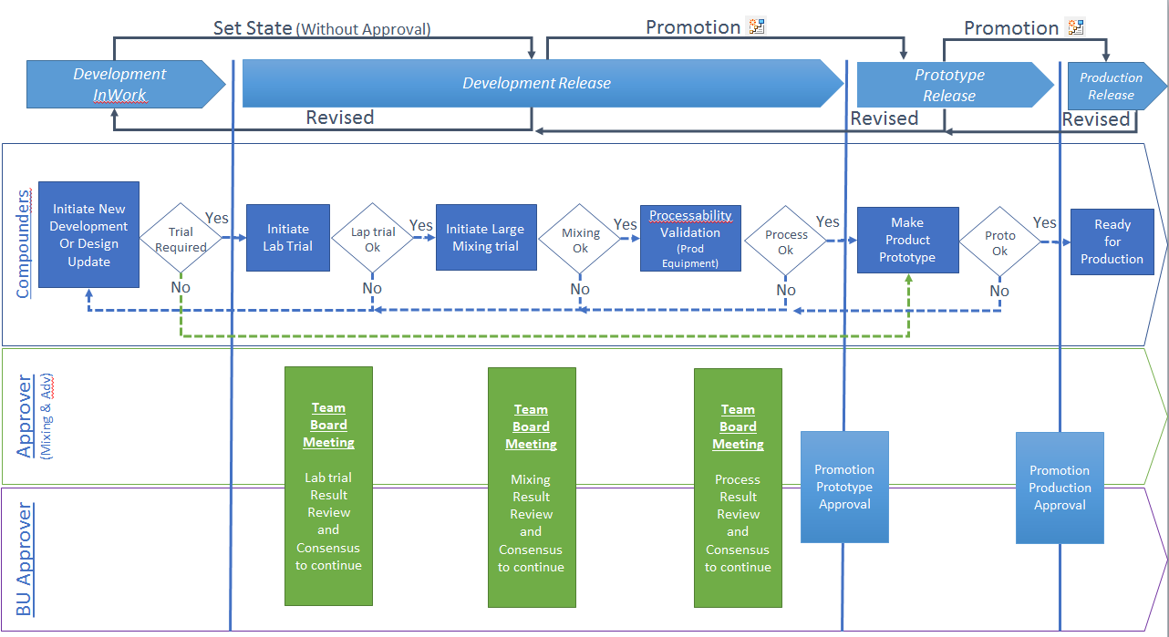

When initiate Lifecycle transition

Slide 7
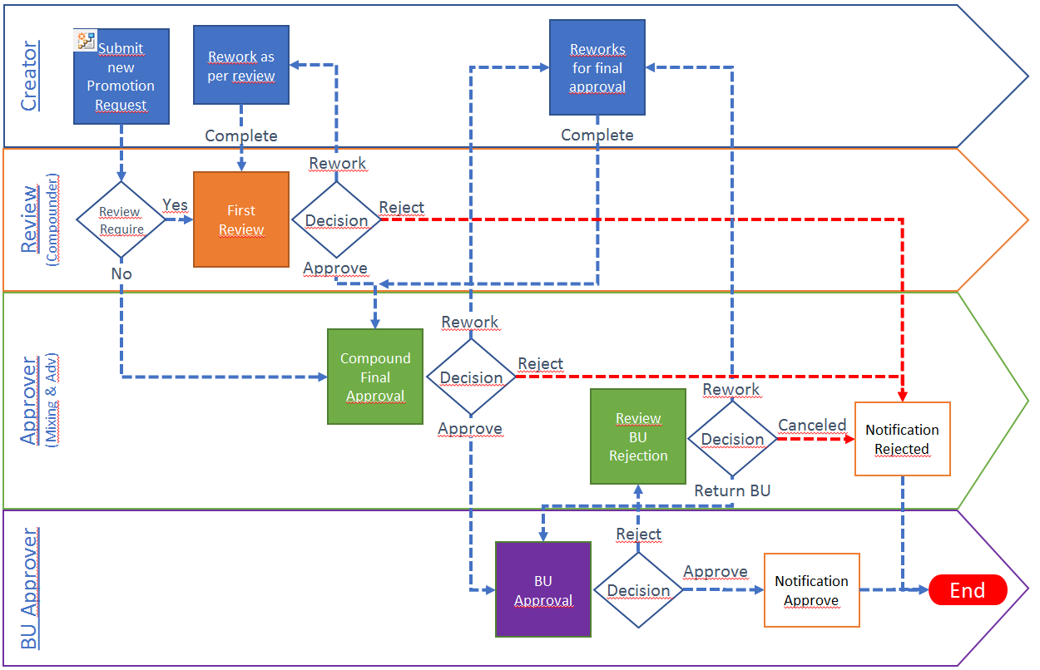
Promotion Process Workflow

Slide 8
Site Variation creation
The different locations are: CMP
VT
API
AB
CSV
Ex: C00110-API

Slide 9


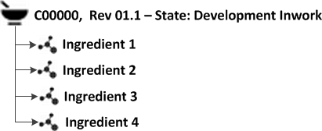
Multiple version creation
Revised
Revision Latest Iteration
New Rev Version
Revision Latest Version

Slide 10
Association Spec document
Most employees of manufacturing companies are familiar with the part structures for products. It is natural to locate product documentation by navigating the relationships from a part in the part structure.
For this reason, Windchill provides part-to-document connection. Compounds documents are connected to parts using the Described By relationship.

Slide 11
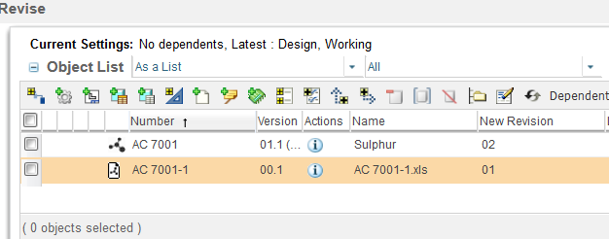

Compound Spec revision
When you revise either a compound or a Raw mat containing specifications. Windchill will auto collect the related documents or compound/RAW. You then decide if you would like to revise only the compound.
CAUTION: You cannot revise the document alone, this will break the link between the specification and the compound or RAW object.

Slide 12
Working with multi-versions

Slide 14
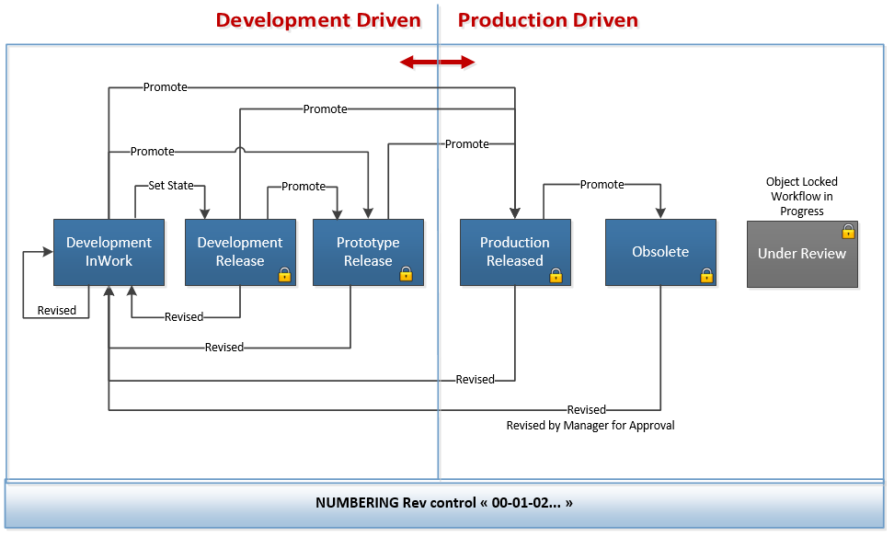
Lifecycle
All potentiel use case

Slide 15

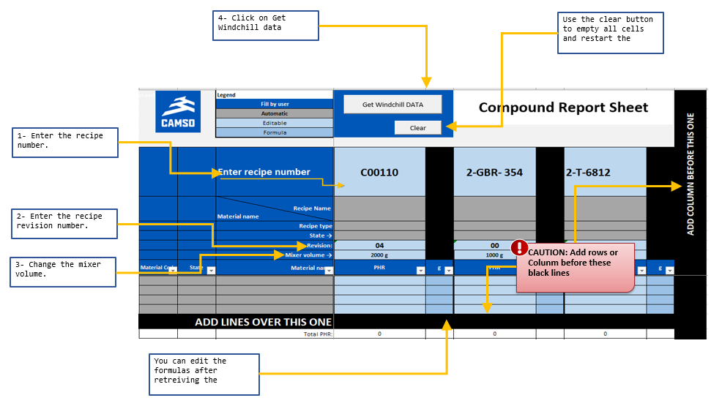
Compare using the Excel Windchill report
To download the windchill Compound excel Report goto PTR-Material Standard folder click the Excel logo to open it.

Slide 16
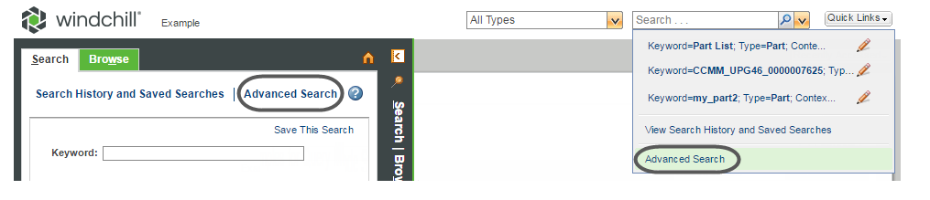
Advance search Demo
Use the Windchill advanced search capability to perform detailed search queries.
Advanced search also allows frequently used searches to be saved, shared with others, altered, and reused.
To access the advanced search, open the Navigator and select the Search tab. Click Advanced Search at the top of the tab.
Demo:
Click the side bar to expand it.
Click the SEARCH tab.
In the type box select Compound
In the criteria select Hardness Shore A > 50
second criteria select Hardness Shore A < 70

Slide 17
End

